Slide 1
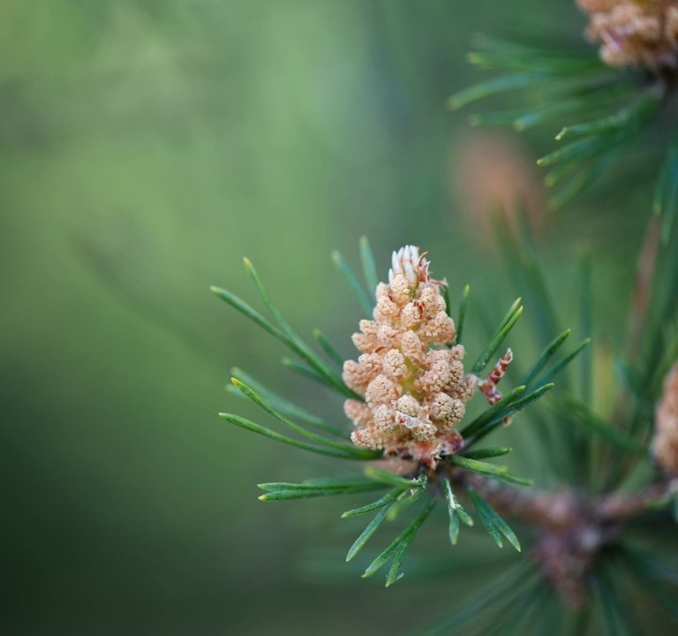
An Overview of forest Trends
Miguel Williamson

Slide 2
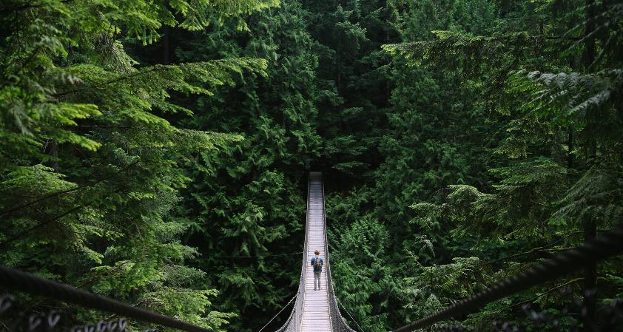
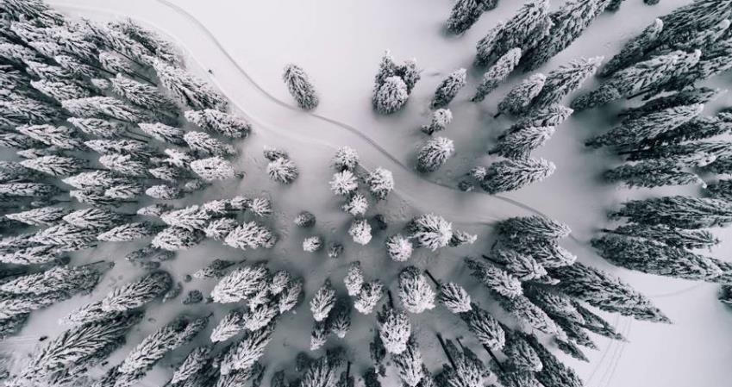
Introduction
This is a synopsis of forest trends between 1990 and 2020. We will be going of the percent change and land area change of countries over the course of the past 30 years.

Slide 3
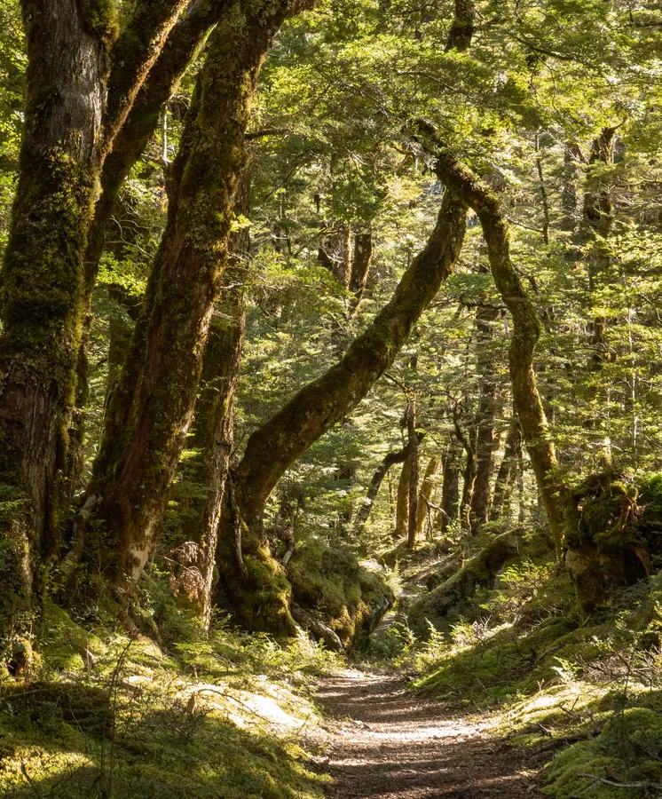
Agenda
First
Land
Going over the countries with the most land in general and talking about the differences between percentage area and actual area.
Second
Forest Increase
Showing the forest increase by forested land area and percentage of forested land
Third
Forest Decrease
Showing the forests decrease by amount of land deforested and percentage of deforested land

Slide 4
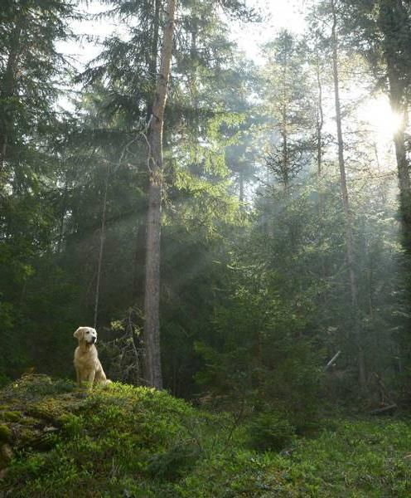
Land area
Both large percentage and large area increases are a good thing same with deforestation being a bad thing for both. However, percentages should be celebrated on a country scale while land area is more celebrated on a international scale.

Slide 5
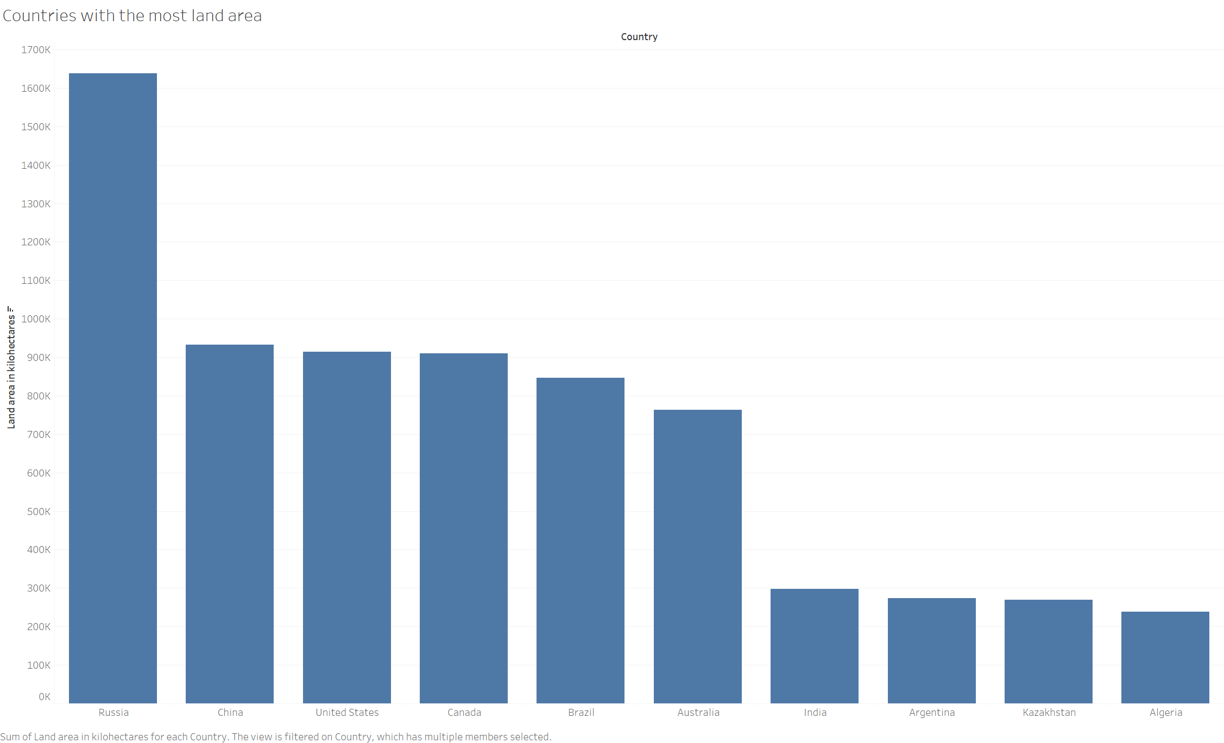
Countries With the Most land Area

Slide 6
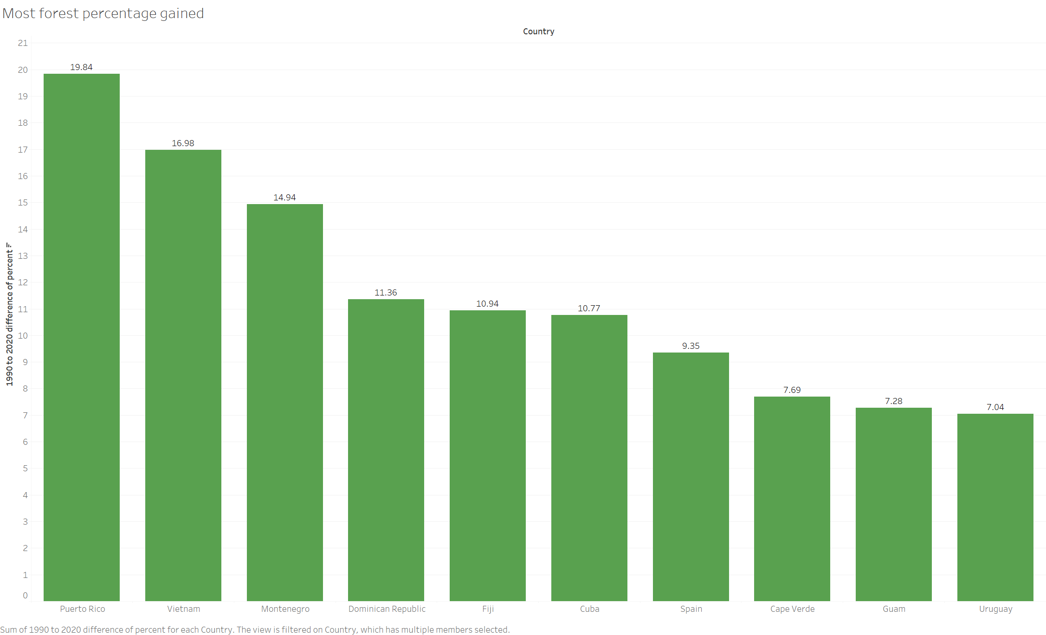
Most forest percentage gained

Slide 7
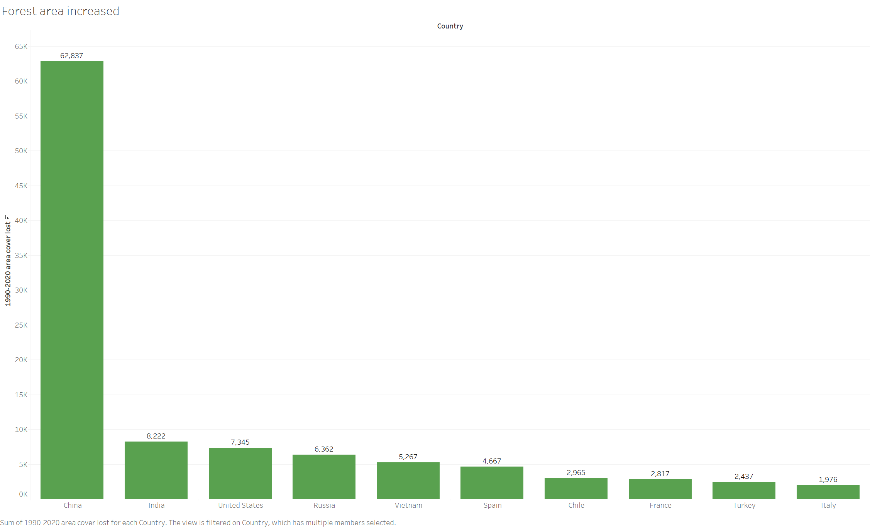
Forest area increased
62,837
Kilohectares
155,273,608
Acres

Slide 8
Two highest forest increase
China
Puerto Rico
China had the biggest reforested area in the world by a large margin
China has dubbed this project the “Green Wall” and it is meant to fight desertification from the Gobi desert.
This is impressive on a global and national scale and is definitely worth praise.
Puerto Rico while not in the top 10 for area of forest planted has jumped to number one for most percentage of their country that they have reforested.
According to “The Atlantic” 80 years ago Puerto Rico was only 6 percent forested, but now is at almost 20.

Slide 9
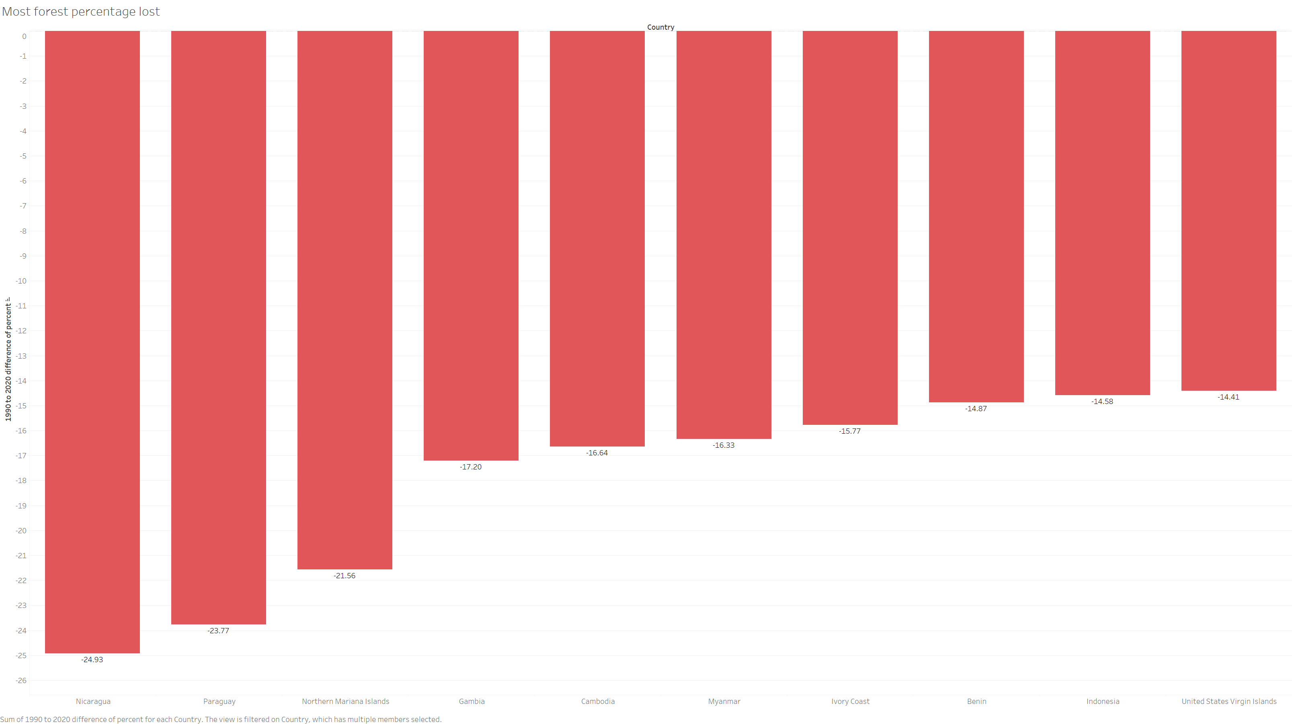
Most forest percentage lost

Slide 10
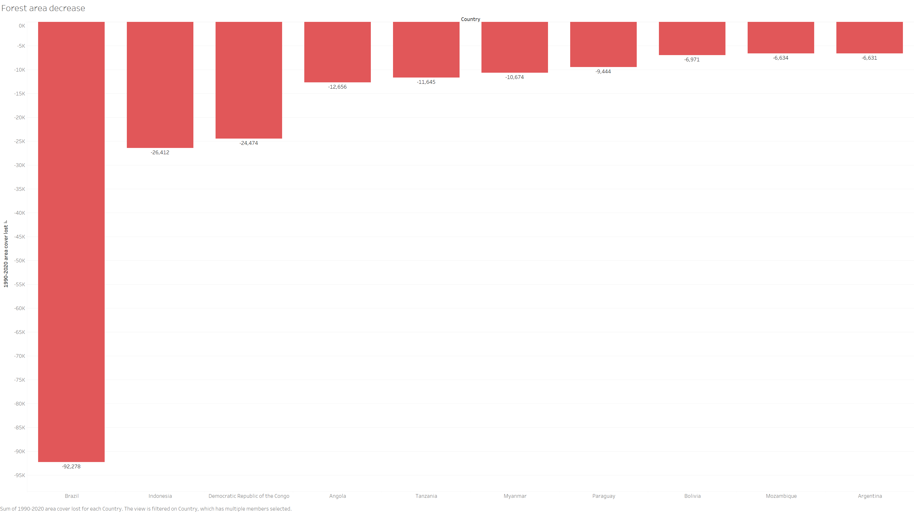
Forest area decrease
92,278
Kilohectares
228,023,903
Acres

Slide 11
Two highest forest increase
Brazil
Nicaragua
Brazil had the biggest deforested area in the world by a large margin
This is catastrophic as they have removed more than 90,000 kilohectares, 30,000 more than China has planted in their “Green Wall” project
This is almost entirely due to agriculture and is particularly bad as Brazil is home to the world’s largest rainforest the Amazon which is one of the world’s largest carbon capturing ecosystems
Nicaragua is number one for most percentage of their country that they have deforested.
According to www.Forestsoftheworld.org this is mainly due to agriculture as well as some industrial projects.

Slide 12

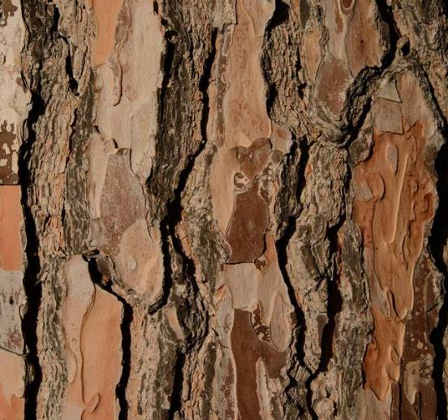

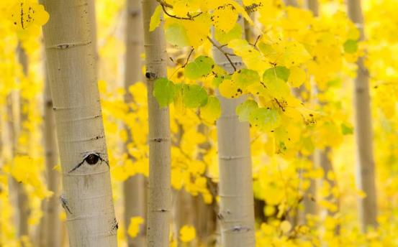
Summary
Puerto Rico and especially China should be congratulated and celebrated on their achievements toward making our plant more green. However, we shouldn’t forget or forgive Nicaragua and majorly Brazil's blatant abuse of the forests they were given.

Slide 13
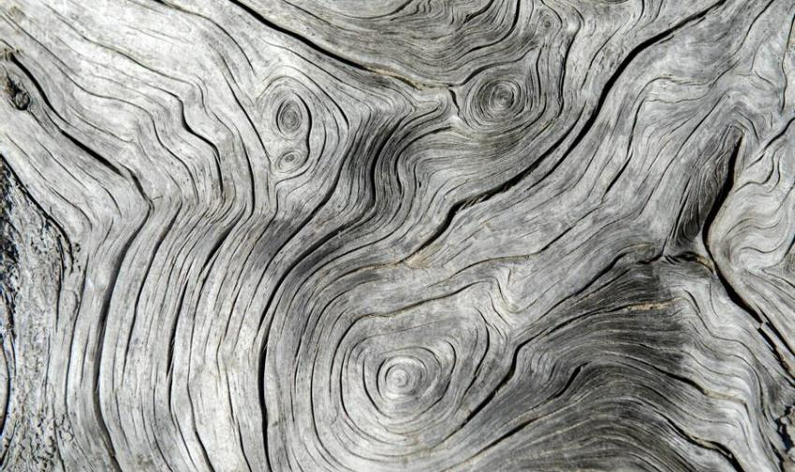

Thank you
Miguel Williamson| pwilliamson2000@gmail.com

